Slide 1
PLACE RECOMMENDATION USING CrewAI and OpenRouter
CSE7301- INTERNSHIP
Final Review
Student Details
Name | Yadhunandhan. R
Roll No | 20211CIT0132
Section | 8CIT-02
Batch No. | CIT-G10
Under the Supervision of,
Mrs STERLIN MINISH
Assistant Professor
School of Computer Science and Engineering
Presidency University
Name of the Program:PIP 4004 INTERNSHIP
Name of the HoD: Dr. Anandaraj S P
Name of the Program Project Coordinator: Dr. Sharmasth Vali Y
Name of the School Project Coordinators: Dr. Sampath A K / Mr. Md Ziaur Rahman

Slide 2
Introduction
The increasing demand for personalized AI-driven experiences has led to the development of intelligent recommendation systems. This project introduces an AI-powered Travel Recommendation System built using CrewAI, LangChain, and OpenRouter, which leverages agent-based orchestration to deliver customized travel plans. By integrating language models with tools like web scraping and real-time APIs, the system dynamically generates travel recommendations based on user preferences, such as place types, age group, and purpose of visit. CrewAI enables modular agent collaboration, making the recommendation process more autonomous, scalable, and adaptive. The architecture promotes a shift from traditional ML-based recommenders to intelligent, multi-agent, LLM-powered systems.

Slide 3
Literature Review
AI Agents and Multi-Agent Collaboration The use of intelligent agents in AI systems has grown with the emergence of frameworks like CrewAI. These systems leverage autonomous agents that can reason, delegate tasks, and collaborate with each other to achieve complex goals. Multi-agent systems (MAS) are particularly useful in domains requiring coordination, adaptability, and contextual understanding — such as personalized travel recommendations.
LLM Orchestration in Recommender Systems With the rise of large language models (LLMs), recommender systems have evolved beyond traditional algorithms. Recent advancements allow LLMs to analyze natural language inputs, infer user intent, and query external tools to provide personalized results. CrewAI integrates LLMs like GPT through OpenRouter or OpenAI APIs to enable autonomous decision-making in task-specific agents.

Slide 4
Literature Review
Tool-Augmented Language Models Tool use in LLMs is a cutting-edge research area. Agents that can call web scrapers, APIs, or databases enhance their knowledge and relevance in dynamic environments. Literature supports this trend by highlighting the benefits of LLMs with tool use for tasks like data extraction, knowledge augmentation, and real-time recommendation generation.
Applications in Travel-Tech and Smart Tourism Agent-based systems are increasingly being explored in tourism, offering scalable solutions for smart city ecosystems. Studies suggest that personalized, real-time travel guides powered by AI can improve user satisfaction, accessibility, and sustainable exploration of destinations — aligning with smart tourism and sustainable development goals (SDGs).

Slide 5
Literature Review
Data Pre-processing and Model Training
Effective data pre-processing is crucial for recommender systems. Sparse rating matrices, as found in the dataset used in this study, require techniques such as matrix factorization or sparse matrix representations to optimize computations (Koren et al., 2009). The use of a sparse matrix representation with the Scikit-learn k-NN model enables the system to efficiently compute similarity scores among places.

Slide 6
Objectives
1. Multi-Agent System Design Design and implement a multi-agent AI architecture using CrewAI, where each agent has a specific role such as user preference analysis, place recommendation, and data retrieval.
2. Agent Specialization and Role Definition Develop autonomous agents (e.g., Travel Analyzer and Place Recommender) with defined goals, backstories, and responsibilities to perform end-to-end decision-making collaboratively.
3. Language Model Integration Leverage OpenRouter’s API with LLMs (e.g., GPT-3.5/4) to power the agents' reasoning capabilities, enabling natural language understanding and dynamic task execution.
4. Prompt Engineering and Task Delegation Craft detailed task descriptions and agent prompts for effective reasoning, delegation, and output generation through sequential agent workflows.

Slide 7
Objectives
5. Tool-Enhanced Intelligence Integrate tools like custom web scraping agents to extract real-time data from tourism websites, enhancing the system’s accuracy and relevance in recommendations.
6. Real-Time Travel Recommendation Generation Use autonomous reasoning and external data sources to recommend personalized places to users based on constraints like location, age group, place type, and ratings.
7. Error Handling and Robust Execution Implement safeguards for API/tool failures, timeouts, and irrelevant content to ensure system reliability and consistency in varied internet conditions.
8. Alignment with SDGs & Smart Tourism Ensure the system supports sustainable and inclusive tourism goals (SDG 9 and 11) by guiding users to culturally relevant, safe, and less-crowded destinations.

Slide 8
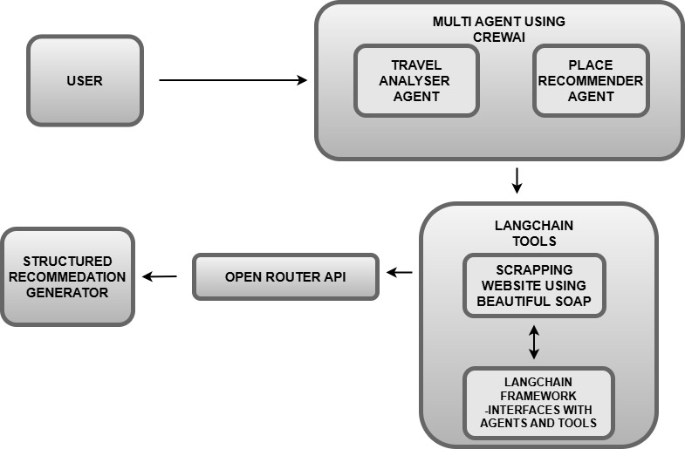
Algorithm

Slide 9
Algorithm
Step 1: User Input Analysis
Accept natural language input from the user (e.g., “I’m visiting Bangalore with my kids aged 5 and 10, looking for amusement parks.”).
Pass the input to the Travel Analyzer Agent.
Step 2: Preference Extraction via LLM
The Travel Analyzer Agent uses the language model (GPT via OpenRouter) to extract structured details such as:
Place type (e.g., amusement parks, temples)
User constraints (age, group type, location)
Contextual preferences (ratings, crowd level, etc.)
Step 3: Task Delegation to Recommender Agent
The Place Recommender Agent receives this structured analysis and proceeds to generate recommendations based on the filtered criteria.

Slide 10
Algorithm
Step 4: Real-Time Data Scraping
The Place Recommender Agent invokes the ScrapeWebsite tool to extract live content from tourism websites relevant to the request.
Step 5: Intelligent Filtering and Reasoning
The LLM-powered agent interprets the scraped content and filters relevant places.
Prioritizes based on keywords, ratings, and semantic matches to user preferences.
Step 6: Recommendation Generation
Generates a list of 3–5 recommended places.
Each includes: Name, Type, Description, Coordinates (Lat/Long), and Reason for Recommendation.

Slide 11
Internship Road Map
Review 0
Understanding the role and internship
Review 1
Introducing the actual Project
Review 2
50% Completion of the project
Review 3
100% completion of the project

Slide 12
Expected Outcome
Personalized Travel Suggestions The system will generate highly relevant and customized place recommendations based on user input, such as age group, interests, and location.
Autonomous Agent Collaboration Multiple agents will coordinate using CrewAI to analyze user needs, extract relevant data, and provide intelligent suggestions without manual intervention.
Real-Time Information Retrieval The integrated scraping tool enables agents to gather live data from trusted tourism websites, ensuring up-to-date and accurate recommendations.
Location-Aware Results Final recommendations include detailed attributes such as place name, type, description, user-fit reasoning, and coordinates (latitude & longitude).
Scalable AI Framework The modular, agent-based design enables future expansion into more cities, user categories (solo, couples, senior citizens), or recommendation types (food, events, hotels).

Slide 13
Conclusion
This project demonstrates a shift from traditional rule-based or ML-only recommendation engines to LLM-powered, autonomous, agent-based systems. By using CrewAI and OpenRouter APIs, the system achieves:
Seamless task orchestration among intelligent agents
Dynamic web scraping to enhance recommendation accuracy
Context-aware decision-making tailored to real-world user needs
The architecture aligns with smart city and sustainable tourism goals (SDG 9 & 11), offering a powerful foundation for future travel-tech innovations. With enhancements like voice input, feedback loops, and multilingual support, the project can evolve into a full-fledged AI Travel Assistant platform.

Slide 14
References
Ricci, F., Rokach, L., Shapira, B., & Kantor, P. B. (2011). Recommender Systems Handbook. Springer.
Resnick, P., Iacovou, N., Suchak, M., Bergstrom, P., & Riedl, J. (1994). "GroupLens: An Open Architecture for Collaborative Filtering of Netnews." Proceedings of the 1994 ACM Conference on Computer Supported Cooperative Work.
Su, X., & Khoshgoftaar, T. M. (2009). "A Survey of Collaborative Filtering Techniques." Advances in Artificial Intelligence.

Slide 15

Project Work Mapping with SDG

Slide 16
Project Work Mapping with SDG
The Project work carried out here is mapped to SDG-9 Industry, Innovation and Infrastructure and SDG- 11: Sustainable Cities and Communities.
Utilizing multi-agent orchestration via CrewAI and real-time data extraction using web scraping, the system proposes a very innovative method of customized travel planning. It is an example of digital infrastructure that can be scaled up, modularized, and well-fitted into smart city ecosystems. The system facilitates innovation in the travel-tech sector by facilitating AI-based decisions based on context and dynamic web content. In accordance with SDG 11, the system makes city life better by assisting users in finding location-specific, secure, and culturally appropriate destinations. It can be further extended to lead tourists to lesser-crowded, eco-friendly destinations, thus facilitating inclusive and sustainable tourism. By way of additional embedding into municipal tourist platforms or public mobility systems, the solution will help create more sustainable, joined-up, and accessible cities.

Slide 17


